Slide 1



EXAM PREPARATION AND
MOCK TEST WEB APPLICATION

Slide 2

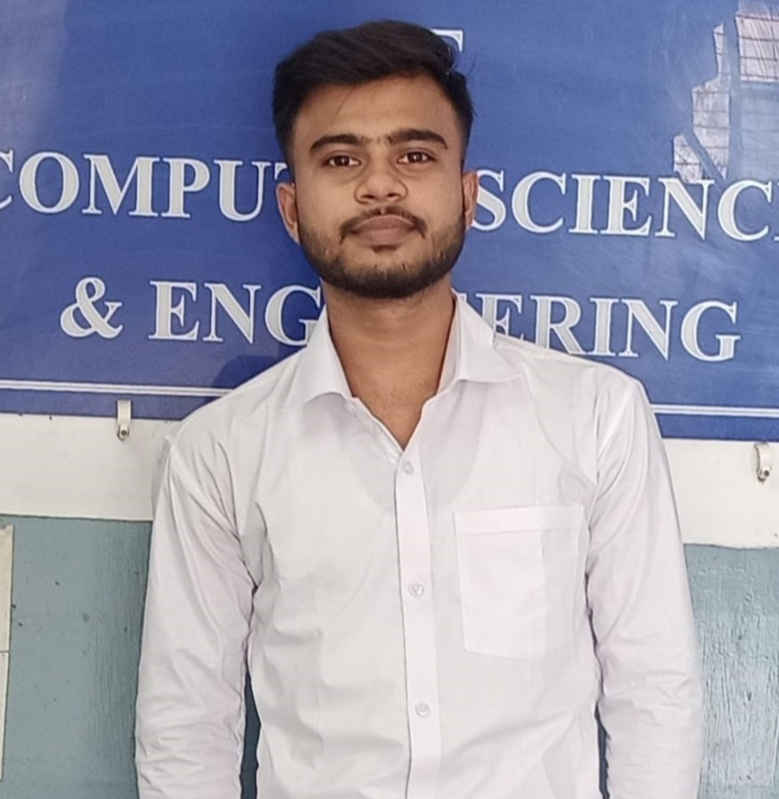


OUR TEAM
PARTHA SARATHI DAS
FRONT-END DEVELOPER
DIP MANDAL
FRONT-END DEVELOPER
SOUMYADEEP DEY
BACK-END DEVELOPER
BISWAJIT MANNA
BACK-END DEVELOPER

Slide 3
INTRODUCTION
This project aims to develop a Mock Test Website designed to help students prepare for exams by providing an online platform where they can take practice tests.
Students can prepare for different entrance exam.
The website will feature a variety of questions across all Computer Science subjects and simulate real exam conditions with a timer and instant feedback as well as students will aware particular exam’s pattern.
We will offer a user-friendly interface and detailed performance reports, this project will provide students with a valuable tool to assess their knowledge and improve their exam preparation.

Slide 4
OBJECTIVE
Our main objective is to give the students a user-friendly interface where they can give mock tests on different Computer Science subjects as well as Aptitude, Verbal, Reasoning, other necessary Science topics and they need not to go other websites for different subjects.
Take your programming to the next level with DSA!
We want to provide an interface in the same website where one student can prepare themselves for different Entrance Exams like GATE, WBJECA etc.
Another objective to provide topic-wise study materials or youtube playlists.

Slide 5
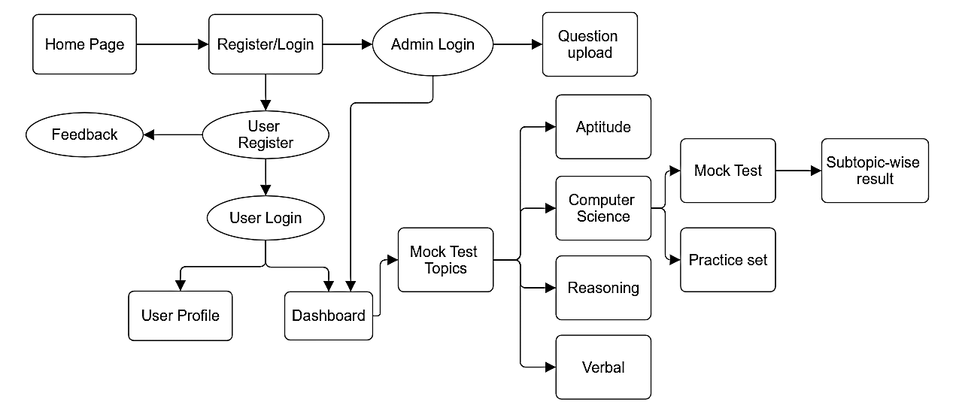
BLOCK DIAGRAM

Slide 6
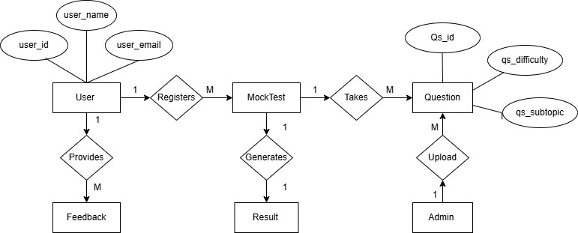
ER DIAGRAM

Slide 7
Specifications
User Registration:
Users must be able to sign up and log in using their email.
User Dashboard:
After login, users can select either MockTest or Interview preparation or Entrance preparation .
Mock Test Creation:
The platform should allow the creation of mock tests based on subjects.
Practice Test Customization:
Users should have the option to select the type of test (subject, difficulty, time limit).

Slide 8
Specifications
Test Attempt and Timer:
Users will attempt mock tests with a timer to simulate exam conditions.
Result Analytics:
After completing a test, users should be able to see a performance report, including scores, time taken, and areas of improvement.
Study Materials:
Notes, practice problems, and video links for each subject available for users.

Slide 9
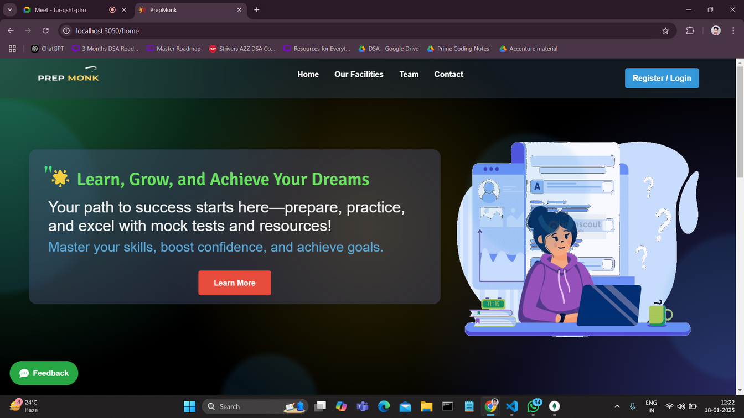
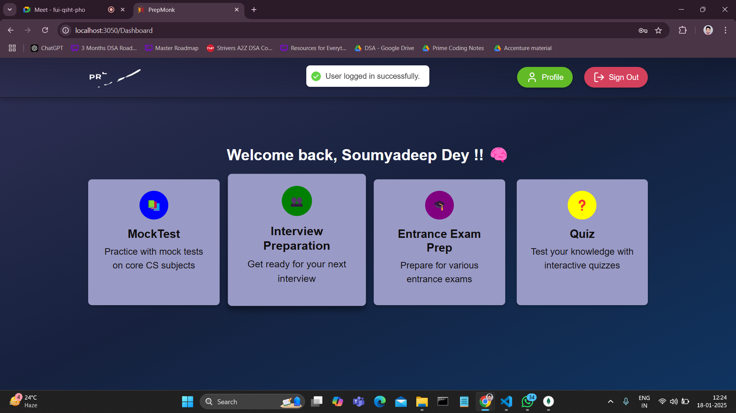
RESULT
02

Slide 10
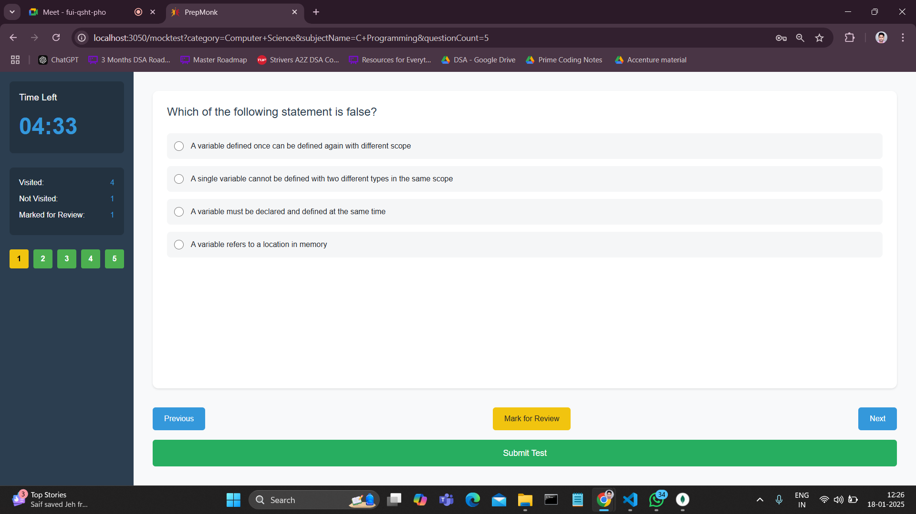
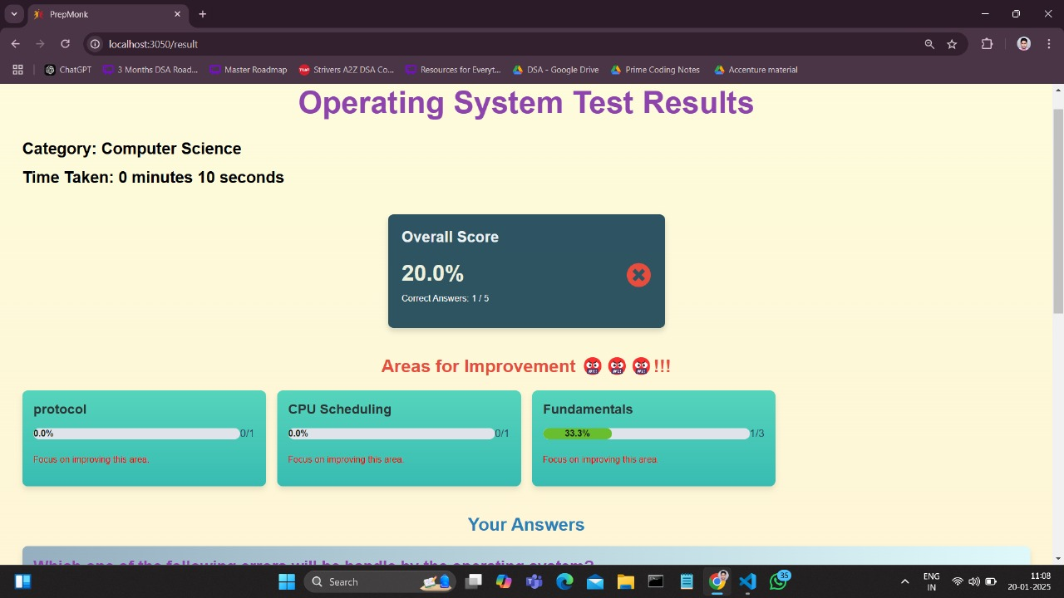
RESULT
02

Slide 11
TECHNOLOGY USED
FRONTEND:
ReactJS for dynamic user interfaces.
BACKEND:.
Node.js for server-side logic.
Express.js for building the REST API.
MongoDB for Database.
Authentication:
JWT (JSON Web Token) for secure user authentication.

Slide 12
ADVANTAGES
Student can select the number of question he/she want to give the Mock Test.
Aptitude test, Computer Science subject wise and all subject test , Entrance exam preparation and topic wise study materials , all are in one website.
Student can give the MockTest with timer.
There is a practice set for all the topics with correct answer and proper explanations

Slide 13
ADVANTAGES
User friendly interface and navigation
User can select the question difficulties(Easy, Medium and Hard) in the practice set.
Questions are shuffled in each time Student give the MockTest.
After MockTest student will get subtopic-wise result and area of improvements.

Slide 14
APPLICATION
Practice Set:
Student can easily attempt practice set and improve themselves in such a way of real time simulated exam.
Mock Test:
Student can give their exam with a timer and instant feedback as well as they will aware particular exam’s pattern.
Proper Study Materials:
They can easily access topic-wise playlist and learn about that topic so many times.

Slide 15
FUTURE WORK
Adding interview preparation.
DSA preparation with doubt solving.
Adding Entrance Exam Preparation materials.
Adding quiz functionalities.
Track the Student’s progression.

Slide 16
CONCLUSION
In conclusion, the Exam Preparation and Mock Test Website offers an efficient, user-friendly platform for students and professionals to prepare for exams. It provides customizable mock tests, personalized feedback, all accessible across devices. With features like subject-based tests and detailed results, users are motivated to improve continuously. Future enhancements, including feedback and expanded content, promise to further elevate the learning experience, making this platform a valuable tool for exam preparation.

Slide 17
THANK YOU

